Slide 1
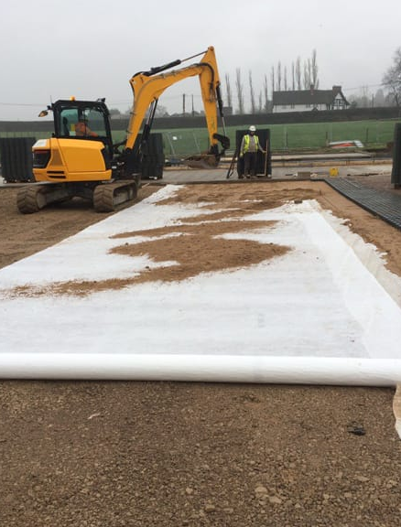
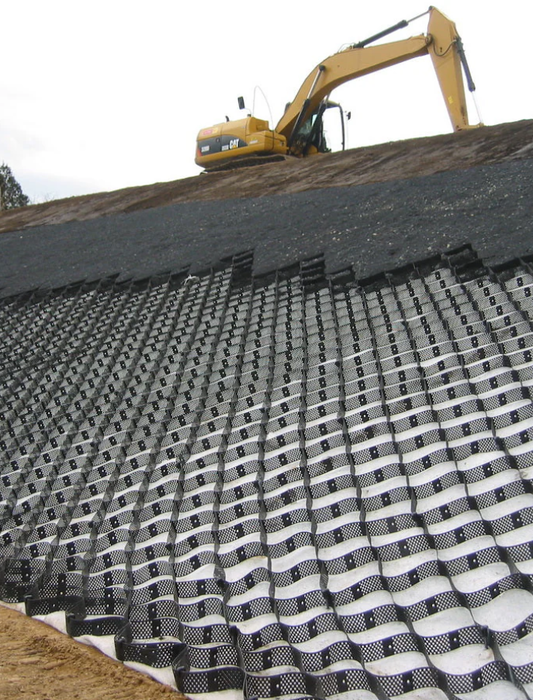
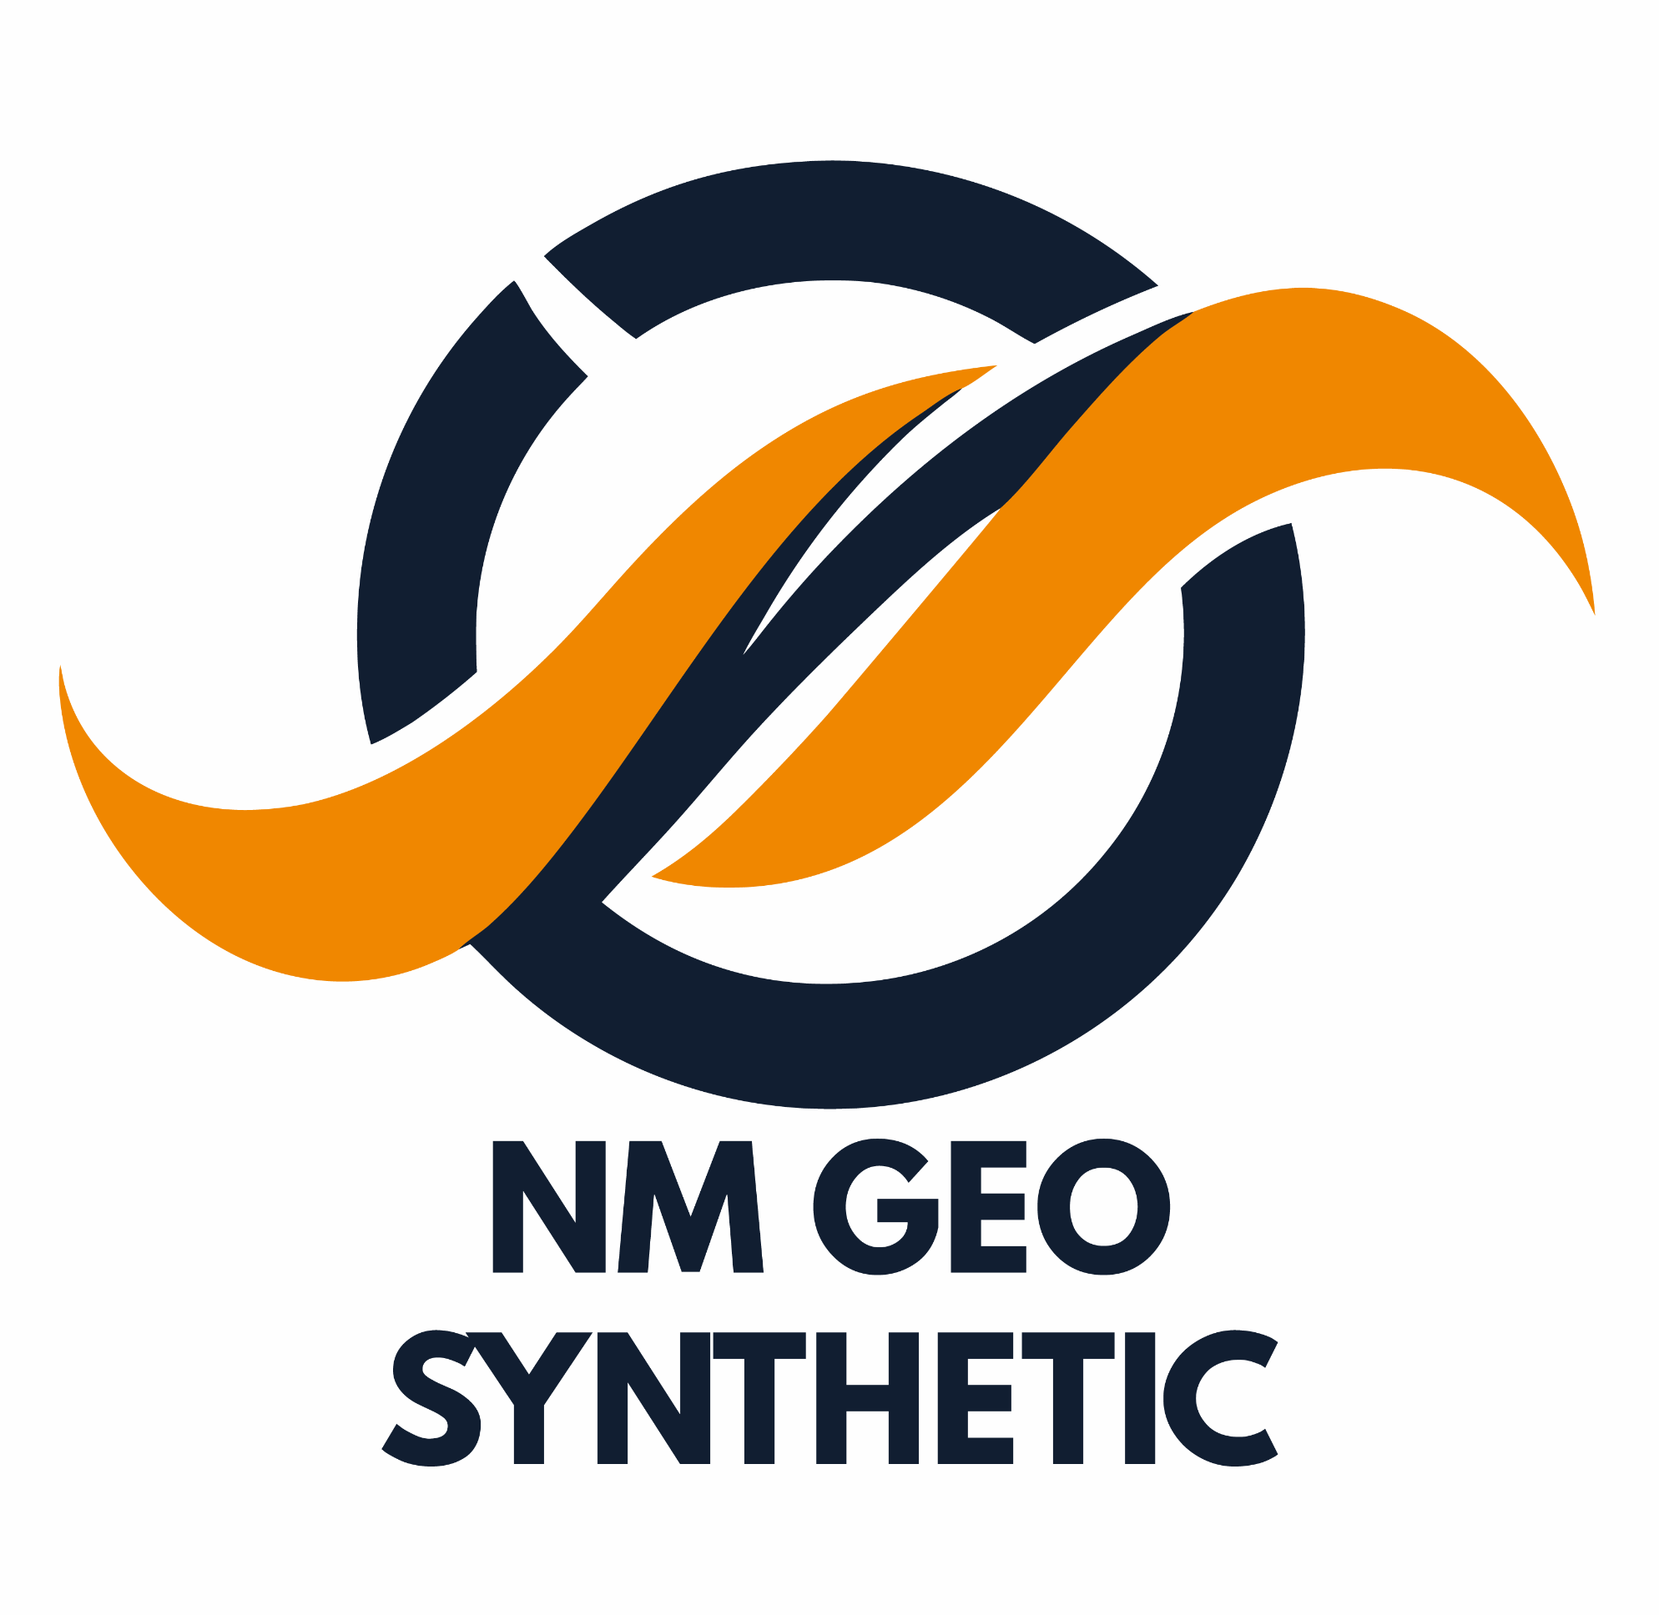
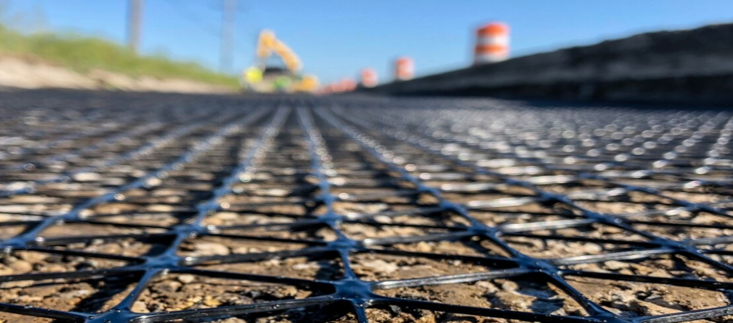



Nm Geo Synthetic
Strong Foundations, Lasting Solutions
NM Geo Synthetic
Nayyer Industries PVT. LTD.
12-C, LDA Avenue, Phase-1, Lahore, Pakistan
21, Block N, Gulberg 2, Lahore, Pakistan
+92 312 9848 849, +92 316 5620 346
+92 42 357168068, +92 42 357164379
www.nmgeosynthetic.com
www.nayyerindustries.com

Slide 2

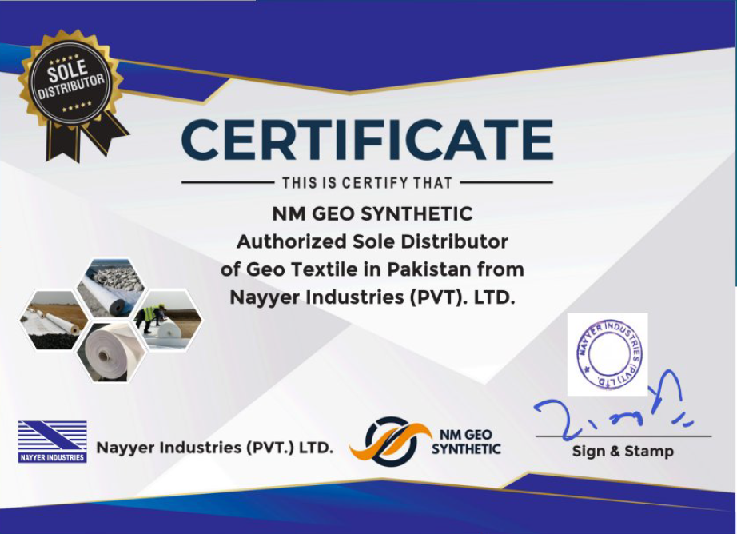
2
NM Geo Synthetic – Authorized Sole Distributor of Geo Textile in Pakistan from Nayyer Industries PVT. LTD.

Slide 3
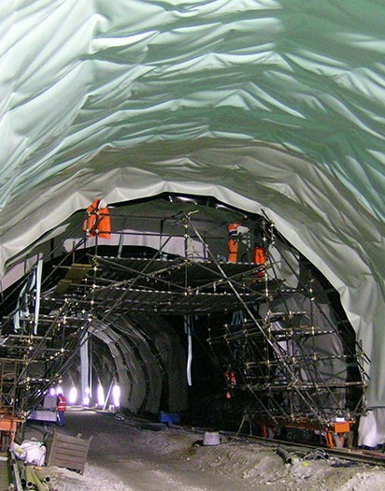
Message from the CEO
3
Assalamu Alaikum / Greetings,a
Welcome to NM Geosynthetic – where every foundation we strengthen, every structure we protect, and every soil we stabilize is a testament to our dedication, craftsmanship, and vision for a more resilient future.
Since our founding, we have made it our mission to deliver more than just products. We deliver trust. From Lahore to the farthest reaches of Pakistan, our geosynthetics solutions – including geotextiles, HDPE, LLDPE, PVC membranes, geogrids, geocells, and more – are engineered to meet the highest standards of performance, durability, and environmental responsibility. Our clients choose us because we turn complex challenges into dependable solutions.
What drives us forward is not only the desire to build, but to build well – to support infrastructure that lasts, to protect our natural resources, and to uplift communities through innovation. This means rigorous quality control, attentive customer support, expert technical guidance, and continuous improvement in all we do.
As we look ahead, NM Geosynthetic is committed to:
Expanding our technical capabilities to address emerging engineering challenges;
Deepening our role in sustainable and environmentally conscious development;
Forging partnerships based on integrity, transparency, and mutual growth;
Ensuring that every project we undertake adds value – not just in terms of structure, but in safety, reliability, and peace of mind for those who depend on us.
Thank you to our dedicated team, loyal clients, and trusted suppliers for being part of this journey. It is your belief in us that makes our mission possible.
We welcome you to explore our portfolio, ask your questions, and see how NM Geosynthetic can be your partner in building strong foundations – today and for generations to come.
With Warm Regards,
Mr. Naeem Ur Rehman
Chief Executive Officer, NM Geo Synthetic

Slide 4


About Us
4
Founded in Lahore and serving projects nationwide, NM Geosynthetic is a leading provider and installer of high-performance geosynthetic products. Our core business includes supplying geotextile, geomembrane, geogrid, geocell, and other geosynthetics that improve soil performance, ensure environmental protection, and support sustainable infrastructure.
Vision
Mission
To be Pakistan’s most trusted partner in geosynthetic innovation, delivering products that strengthen foundations and protect the environment.
To serve industries with durable, reliable, and cost-effective ground engineering solutions through innovation, quality, transparency, and exceptional service.

Slide 5
What We Do Core Services
5
We specialize in the design, supply, and installation of geosynthetic systems for a wide range of applications:
PRODUCT / SOLUTION | PURPOSE / KEY BENEFIT
Geotextiles (woven & non-woven) | Soil stabilization, filtration, drainage, erosion control & reinforcement
Geomembranes (HDPE, LLDPE, PVC) | Reliable containment for water storage, landfills, reservoirs, canals etc.
Geogrids & Geocells | Reinforcement in road construction, embankments, slope stabilization.
Geocomposite Membranes & Water-Stops | Improved barrier protection + controlled leakage, waterproofing, joint sealing.
Other Hydrophilic & Structural Membranes | Specialized uses like swell bars, waterproofing membranes in underground or submerged structures.

Slide 6



Quality & Standards
6
We adhere to international standards and best practices for materials, testing, and installation.
Our technical team ensures every product meets performance criteria for durability, strength, sealing, and resistance to environmental factors.
Quality control is built into every step from sourcing raw materials through final project handover.

Slide 7
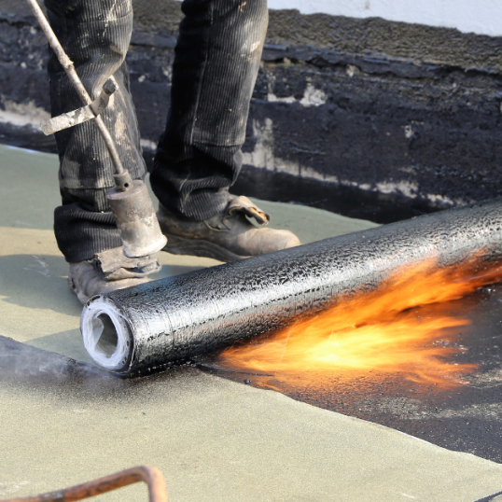
Industries & Applications
7
NM Geosynthetic products are used across a broad range of sectors including:
Civil Infrastructure: roads, embankments, highways
01.
06.
Environmental protection projects (erosion control, filtration & drainage)
Dams, reservoirs & canals
02.
05.
Tunnels, underground structures, basements
Landfills & waste containment
03.
04.
Aquaculture & agriculture

Slide 8




Our Commitment
8
Reliability:
Timely delivery, consistent quality, and dependable project execution.
Technical Support:
From consultation and design to installation supervision, we assist clients at every stage.
Sustainability:
Durable materials and efficient solutions that reduce risk, maintenance, and environmental impact.
Customer Satisfaction:
Transparent communication, after-sales support, and ensuring your project goals are met.

Slide 9
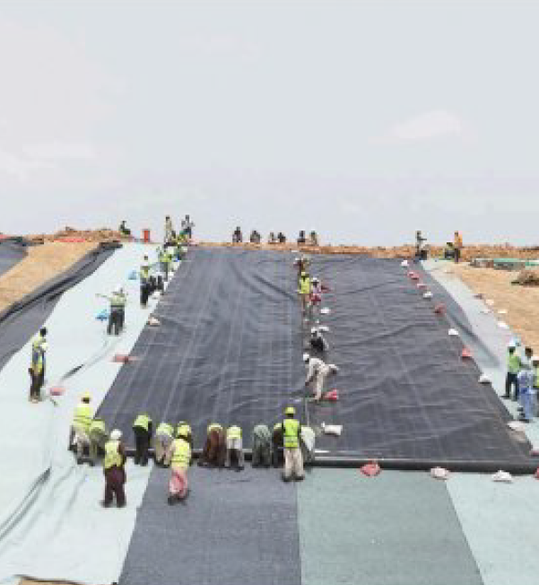
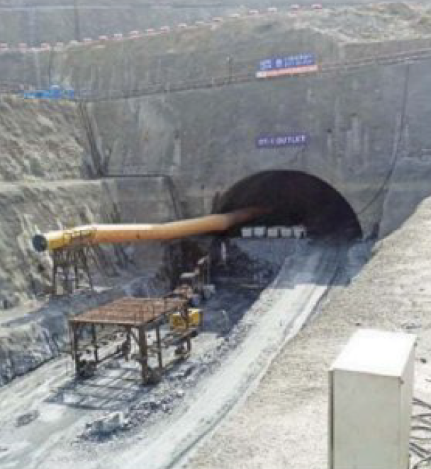
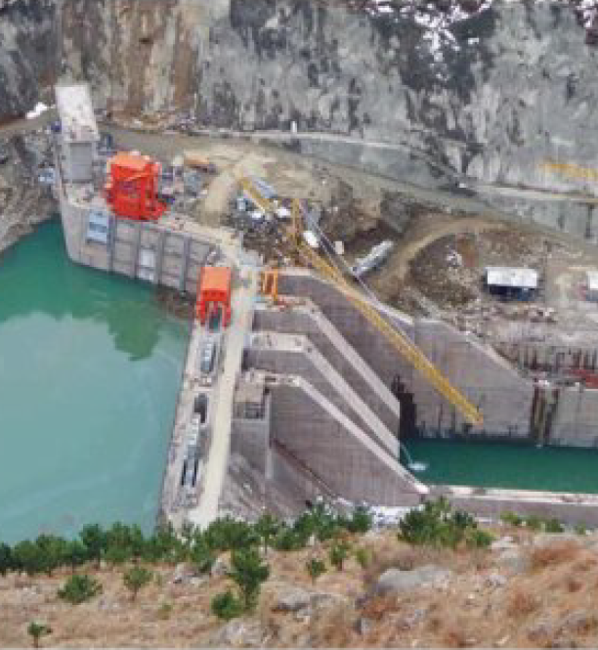
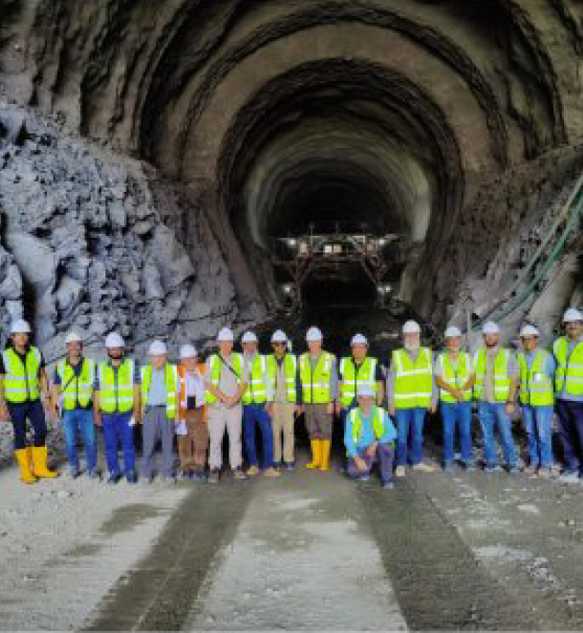
Our Recent Projects
9
KARACHI
LAND FILL
TARBELA DAM EXTENSION 5TH
DASU
DAM
DIAMER
BHASHA DAM

Slide 10
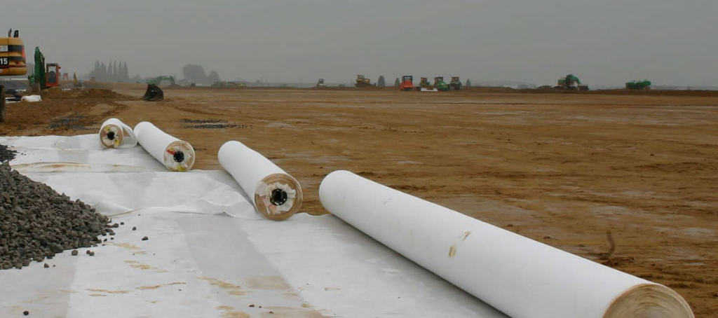
Nm Geo Synthetic
Contact information
NM Geo Synthetic
Nayyer Industries PVT. LTD.
12-C, LDA Avenue, Phase-1, Lahore, Pakistan
21, Block N, Gulberg 2, Lahore, Pakistan
+92 312 9848 849, +92 316 5620 346
+92 42 357168068, +92 42 357164379
www.nmgeosynthetic.com
www.nayyerindustries.com

